Slide 1



Slide 2

What kind of data do you carry in your body, your habits, or your memories? How could that become a pattern?
Statistically Speaking – Data, Systems, and Abstraction in Visual Art
In contemporary art, data and statistics can become aesthetic material. Artists use patterns, charts, systems, and abstract structures to communicate ideas about society, identity, movement, or memory. These works often blur the boundaries between logic and emotion, control and expression. Students will examine how artists transform personal or public data into meaningful and visually striking compositions.
Art as Data and Code Focus: Pattern, system, and abstraction are forms of visual communication.
Artists may use:
Personal data or mapping (e.g. movement, sleep cycles, migration)
Grids, linework, modular units, or repetitive forms
Rules-based systems (mathematical, cartographic, architectural)
These visual strategies become codes that reveal, conceal, or transform information

Slide 3

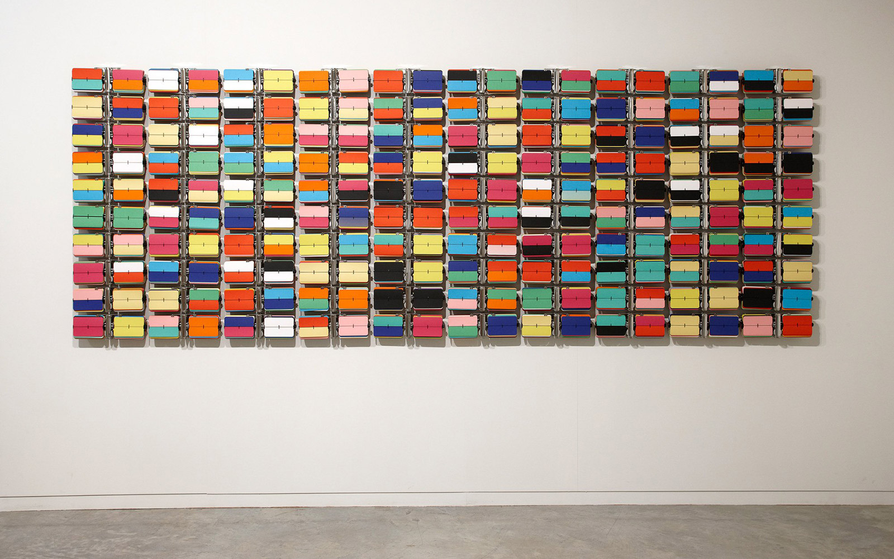
Rebecca Baumman
Rebecca Baumman is a contemporary artist and designer who uses coded marks and repeated visual fragments to create works that appear mechanical but are conceptually human.
Art as Code: Uses tiny symbols or abstract units to represent accumulated experience or movement
Cameron Robbins
Cameron Robbins is an Australian artist whose kinetic installations use natural forces—like wind and tides—to generate mark-making and visual records of movement.
Art as Code: Uses mechanical drawing machines powered by weather data to produce visual translations of real-time phenomena

Slide 4




Jordache Ellapen is a South African-born, Australian-based visual artist and academic whose interdisciplinary work explores queer identity, migration, and movement through layered abstraction. His series Energy and Movement translates statistical and personal data into symbolic, flowing visual forms.
Key Themes in Jordache’s Work:
Queer migration and diasporic identity
Resistance to linear history through abstract mapping
Blending memory with statistical data
Visualising personal geography through cultural codes
JORDACHE, Energy and Movement, 2020, oil on canvas

Slide 5
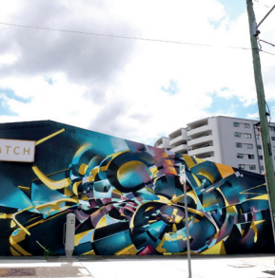


Inquiry Process:
Developing: Mapped personal and ancestral paths
Researching: Used social histories and archival records
Reflecting: Considered how memory resists traditional data structures
Resolving: Produced abstract works that blur cartography, identity, and statistics
Formal Context: Uses abstract linework, spatial layering, and non-linear flow to suggest data while resisting rigid structure.
How does Ellapen use abstract line and mapping to represent identity and movement as data?
Cultural Context: Engages with the complexities of queer identity and migration, challenging how systems traditionally visualise or exclude personal histories.

